Slide 1


SasView : A Small Angle Scattering Analysis Software Package
Andrew Jackson, European Spallation Source
on behalf of the SasView Collaboration

Slide 2
SANS Refresher

Slide 3

Anatomy of a SAS Instrument
Collimation
Source
Guides
or
Optics
Wavelength
Selection
Guides
or
Optics
Sample
Detector
A1
A2
L1
L2

Slide 4
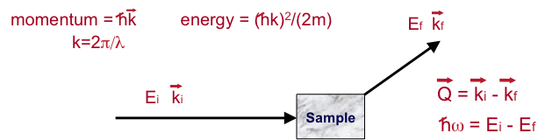
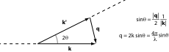
What do we measure?
Measure number of neutrons scattered as function of Q and ω
Intensity of scattering as function of Q is related to the Fourier transform of the spatial arrangement of matter in the sample => Correlations in Space
Intensity of scattering as function of ω is related to the Fourier transform of the temporal arrangement of matter in the sample => Correlations in Time

Slide 5
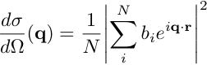
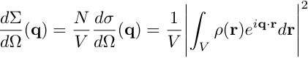
Small Angle Scattering
Having determined that we can use scattering length density to describe our samples, we can replace the sum in
with the integral of the SLD distribution across the whole sample and normalize by the sample volume thus:
This is the “Rayleigh-Gans Equation” and shows us that small angle scattering arises as a result of inhomogeneities in scattering length density.

Slide 6
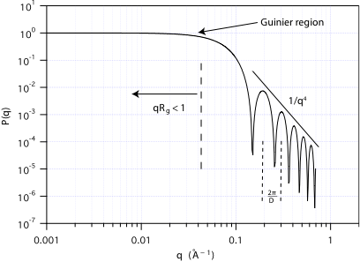
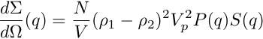
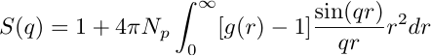
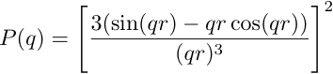
Form and Structure Factors
In small angle scattering we confuse terminology by often splitting the scattering structure factor into a Form Factor, P(q) and a Structure Factor, S(q) when considering particulate systems :
P(q) represents the interference of neutrons scattered from different parts of the same object, while S(q) represents interference between neutrons scattered from different objects. If there is no interparticle correlation (e.g. it is a dilute solution) then S(q) = 1.
If we have an isotropic solution then
where g(r) is the particle pair correlation function and is related to the interaction potential between particles.
The form factor for a sphere (shown above) is given by:

Slide 7
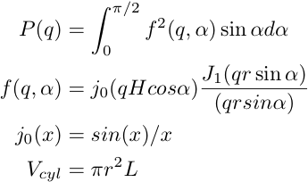
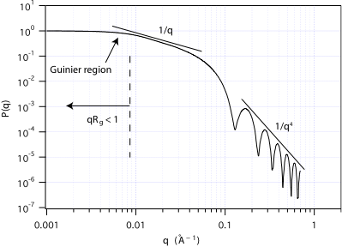
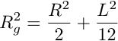
Form and Structure Factors
The form factor for a cylinder is given by:
where J1 is the first order Bessel function and ɑ is defined as the angle between the cylinder axis and the scattering vector q.
The radius of gyration of a cylinder is given by
where R is the radius and L the length of the cylinder.

Slide 8
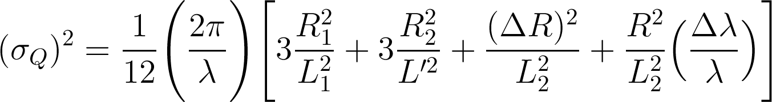
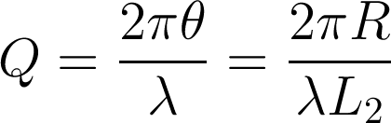
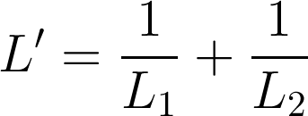
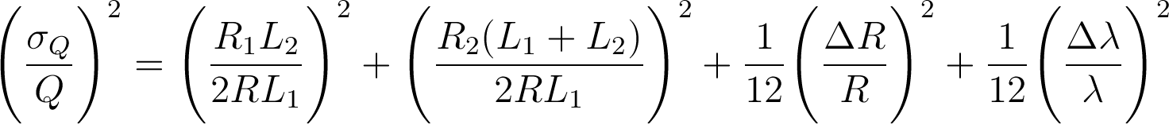
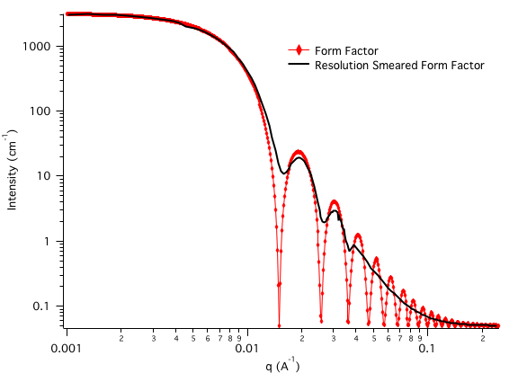
SANS Resolution
The intensity measured at each nominal Q value is, in fact, a sum of intensities from nearby Q vectors.
This is a result of the beam and the detector pixels having finite sizes, and the wavelength having a spread of values.
The effect is that the scattering that one would calculate is “smeared” by a resolution function.
Difficult to “desmear” reliably, therefore smear model functions in analysis.
A1
A2
Detector
L1
L2
See Mildner & Carpenter, J. Appl. Cryst.17, 1984 for the gory details.

Slide 9
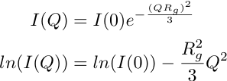
SAS Data Analysis
Model Independent
We can use an approximation from Guinier
to obtain the radius of gyration of the scattering objects assuming particulate scatterers and S(q) = 1.
Similar approximations can be made to get the cross section of cylinders or the thickness of disks. Various other model independent approaches exist to extract information from the data without a scattering model.
Model Dependent
We calculate the form and structure factors for a given scattering system and compare that with the measured scattering data. The model is fitted to the data to obtain the parameters that describe the scattering. We can simultaneously fit multiple contrasts to be able to study complex structures.
The software we will be using for this workshop is called SasView (http://www.sasview.org) and is being jointly developed by NIST, ILL, ISIS, SNS, ANSTO and ESS.
Other software packages for this kind of analysis include the NIST Igor Macros developed at the NCNR and SasFit developed at the Paul Scherrer Institute.
Indirect Fourier Transform
Since we are missing the phase information as a result of the differential cross section being related to the square of the amplitude of the fourier transform, we cannot simply take the fourier transform of our data to get back to ρ(r). Thus we must use an indirect method.
A popular implementation of this method is found in the ATSAS suite of software from Prof. Svergun’s group. SasView also has an implementation of this method.
Ab-inito Structure Generation
An approach that is popular for bio-macromolecules in solution is to generate a structure from many sub-resolution spheres and calculate what the scattering would be. That is then compared with the data and the spheres redistributed. This is repeated until agreement is found.
The ATSAS suite is the primary example of software using this method

Slide 10
What is SasView?

Slide 11
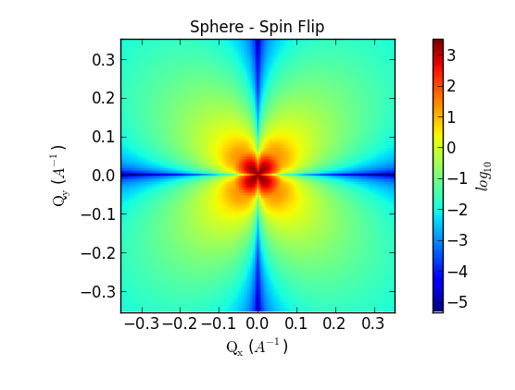
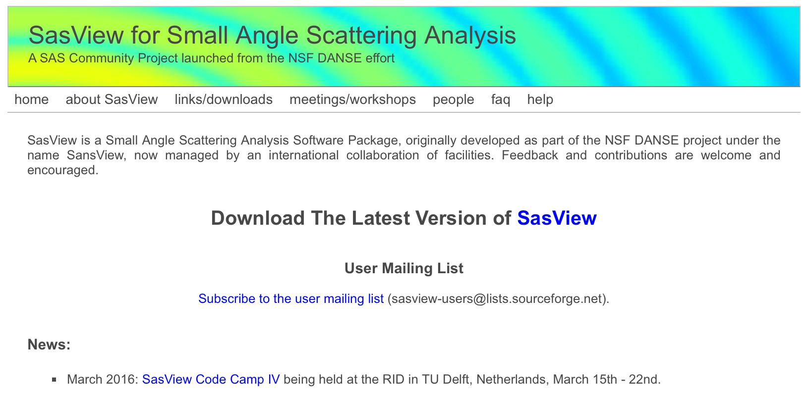
SasView
User friendly, open source analytical modeling of SAS data.
Current Release (3.1.2) Includes:
Large number of 1D scattering models
2D analysis for oriented objects
Batch mode
Magnetic contrast with polarisation analysis
Lots of extra tools
www.sasview.org

Slide 12
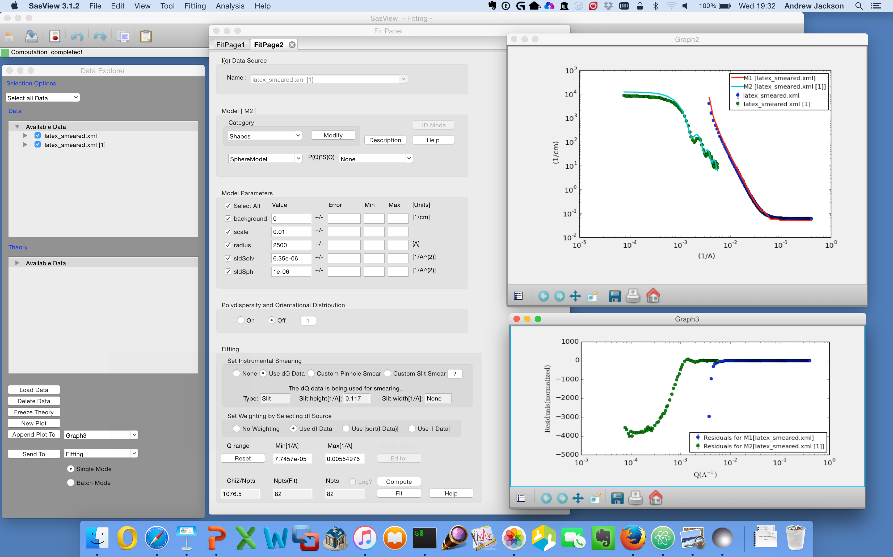
1D Analysis

Slide 13
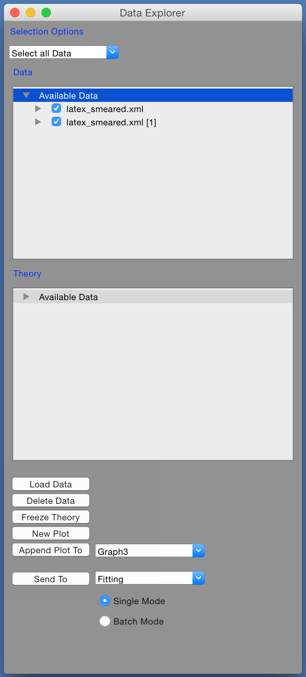
1D Analysis
Load Data …
Select Data Sets …
Here we have SANS & USANS from latex spheres
Send to Fitting …

Slide 14
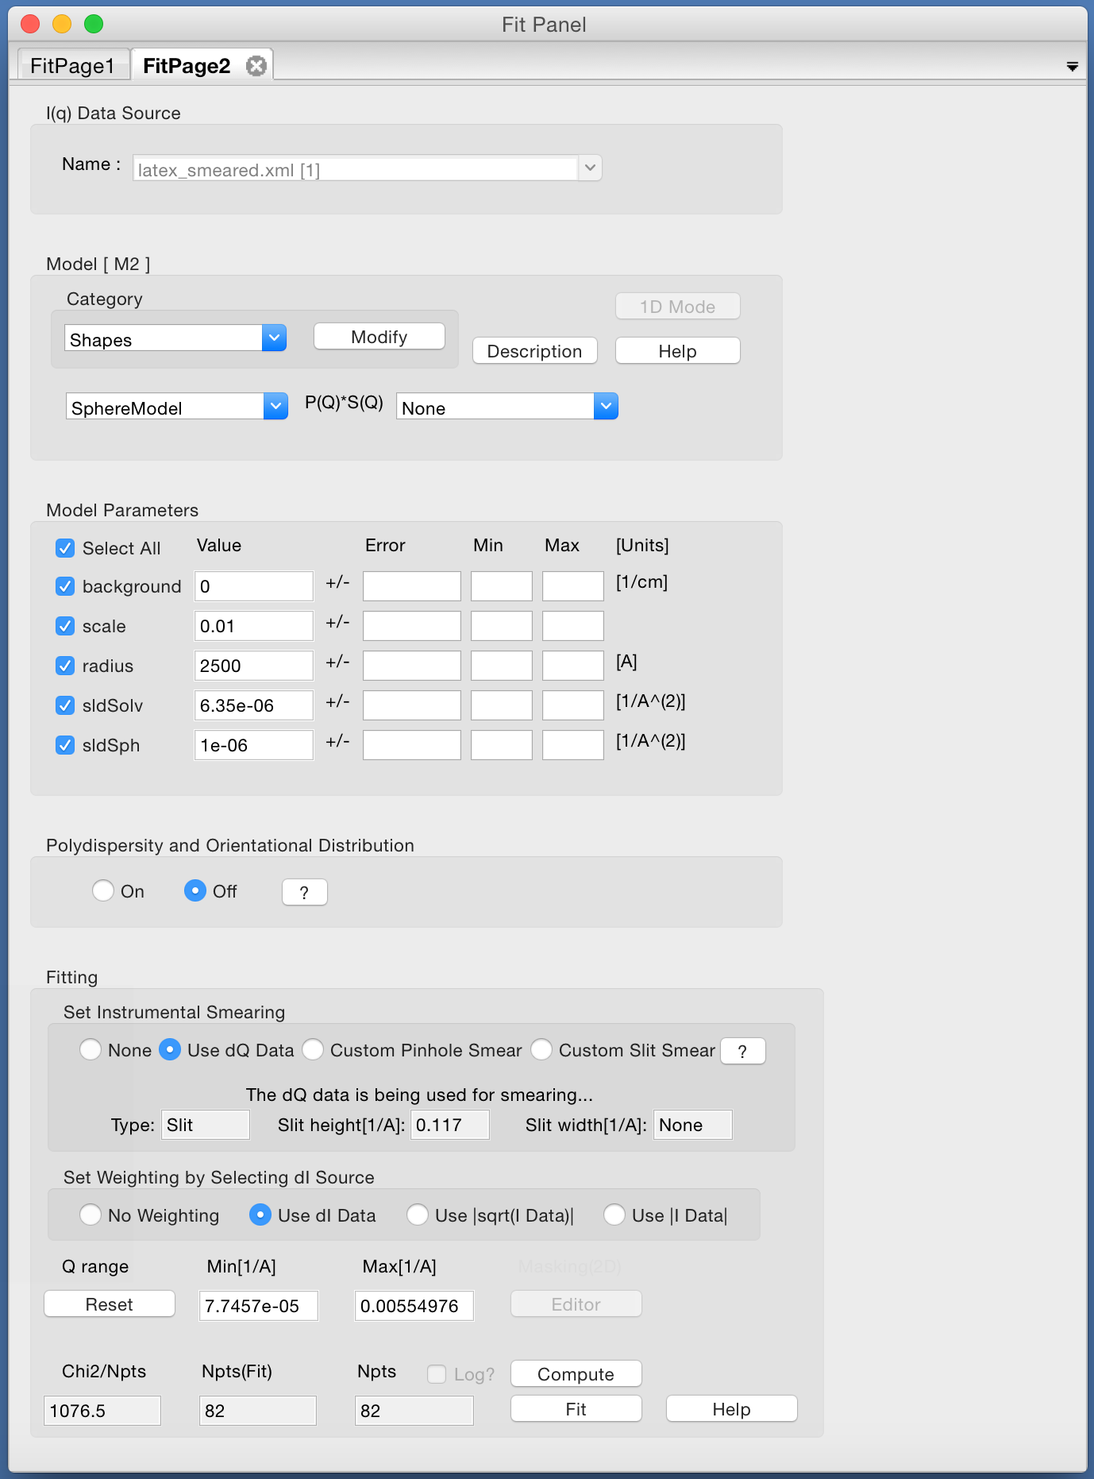
1D Analysis
Send to fitting …
Select a model …

Slide 15
1D Analysis
Send to fitting …
Select a model …
Set parameters …

Slide 16
1D Analysis
Send to fitting …
Select a model …
Set parameters …
Use resolution …

Slide 17
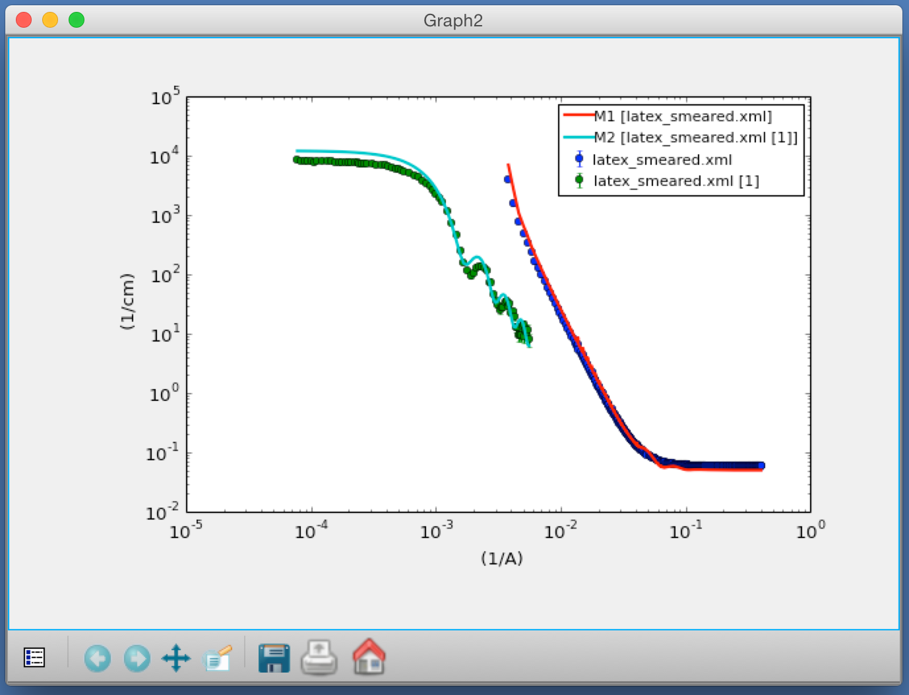
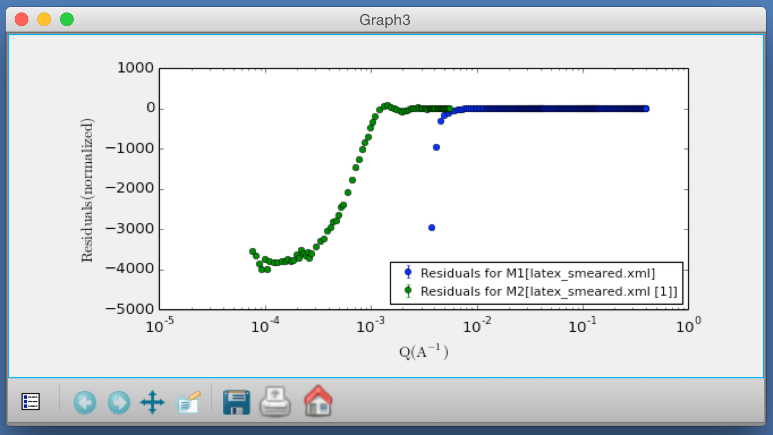
1D Analysis
Send to fitting …
Select a model …
Set parameters …
Use resolution …
How does it look?

Slide 18
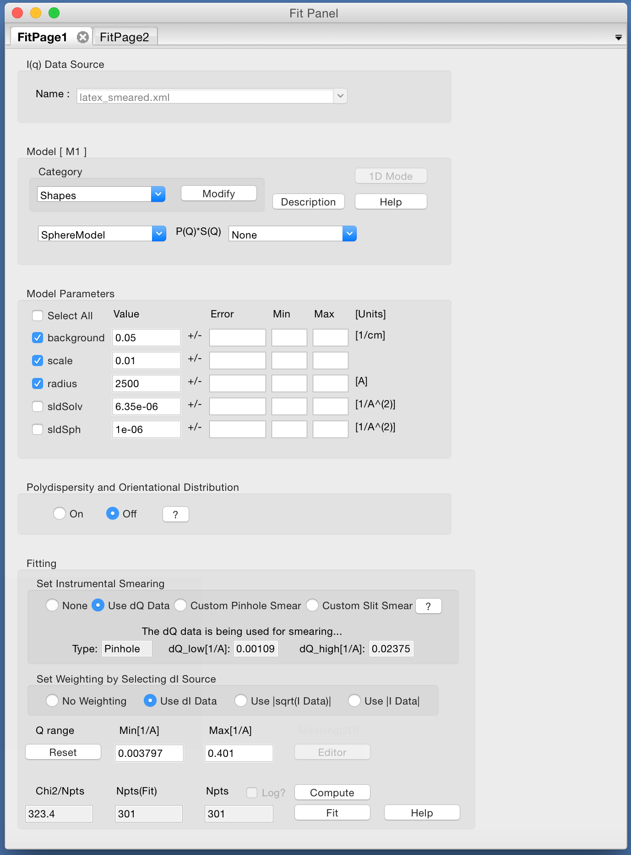
1D Analysis
Choose which parameters to fit …

Slide 19
1D Analysis
Choose which parameters to fit …
… and press the Fit button!

Slide 20
Constraints / Simultaneous Fit
But wait! We have two data sets of the same sample : SANS + USANS …

Slide 21
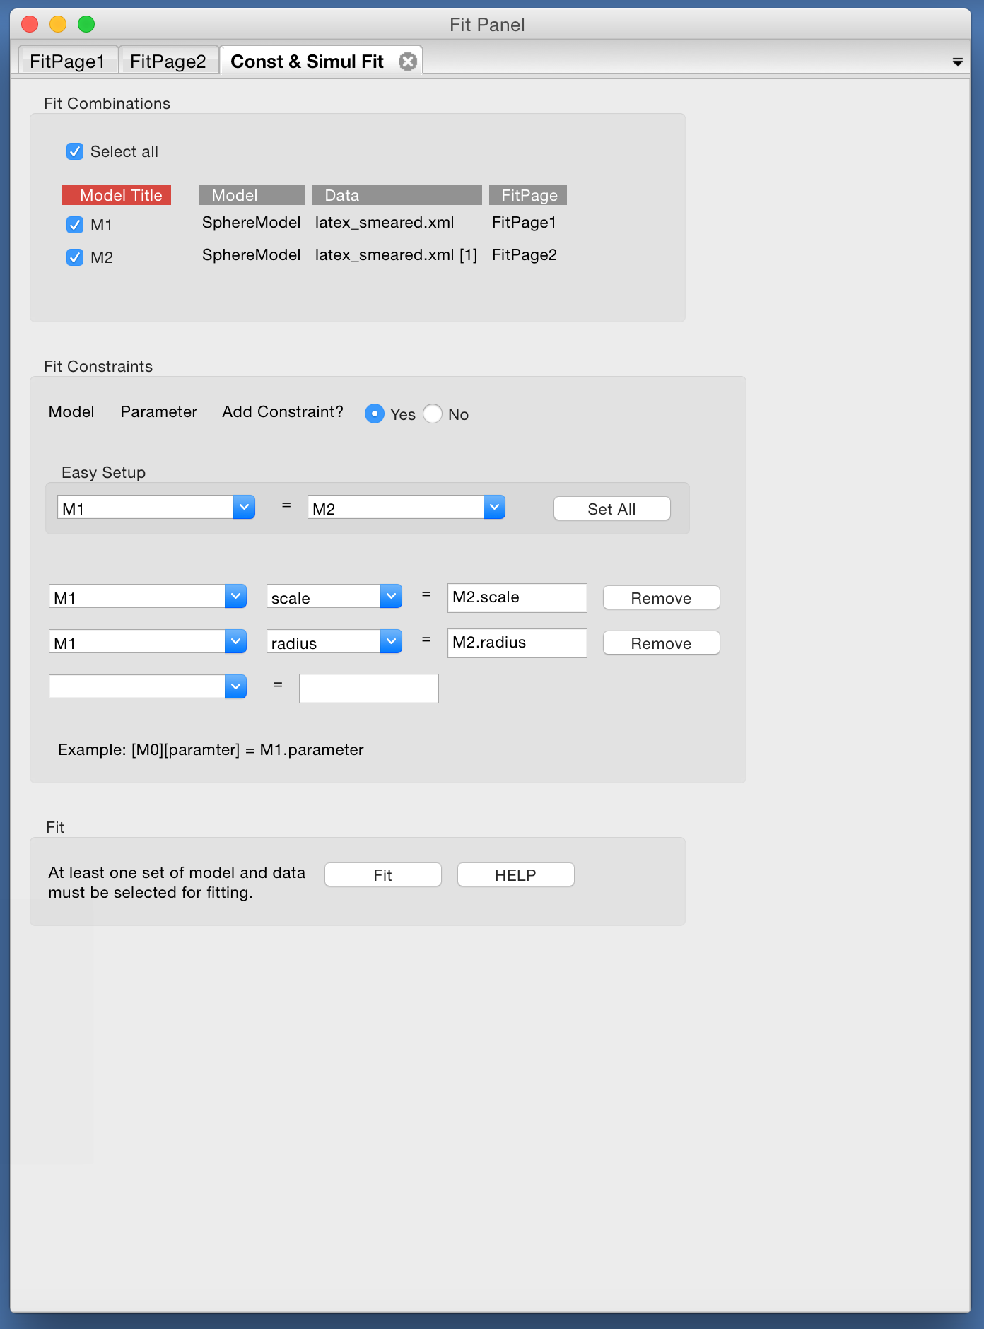
Constraints / Simultaneous Fit
But wait! We have two data sets of the same sample : SANS + USANS …
Set up a simultaneous fit …

Slide 22
Constraints / Simultaneous Fit
But wait! We have two data sets of the same sample : SANS + USANS …
Set up a simultaneous fit …
… with constraints

Slide 23
Constraints / Simultaneous Fit
But wait! We have two data sets of the same sample : SANS + USANS …
Set up a simultaneous fit …
… with constraints
Now press the Fit button!

Slide 24
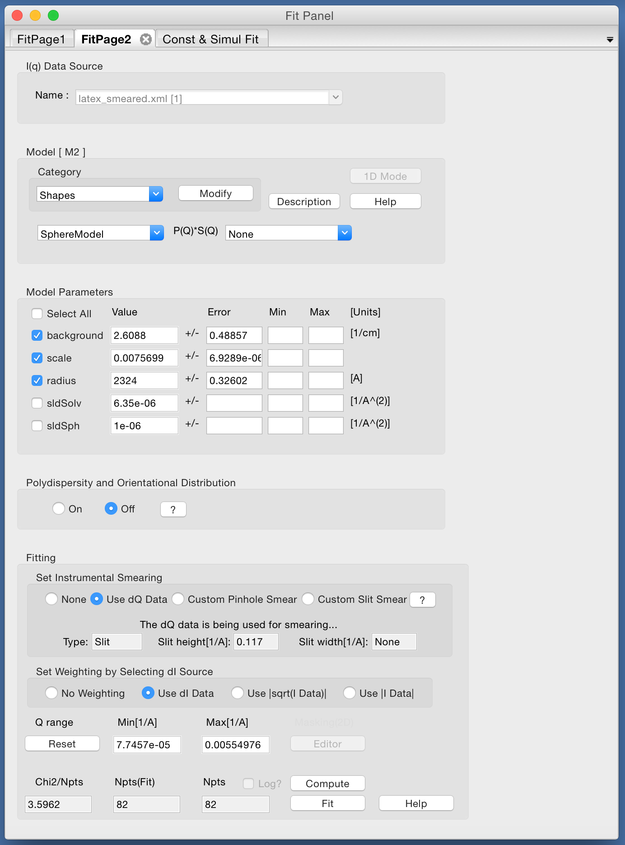
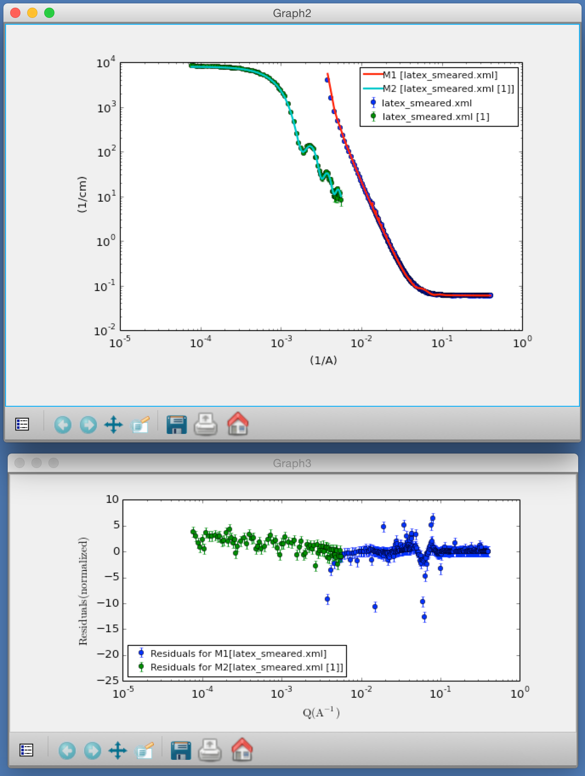
Constraints / Simultaneous Fit

Slide 25
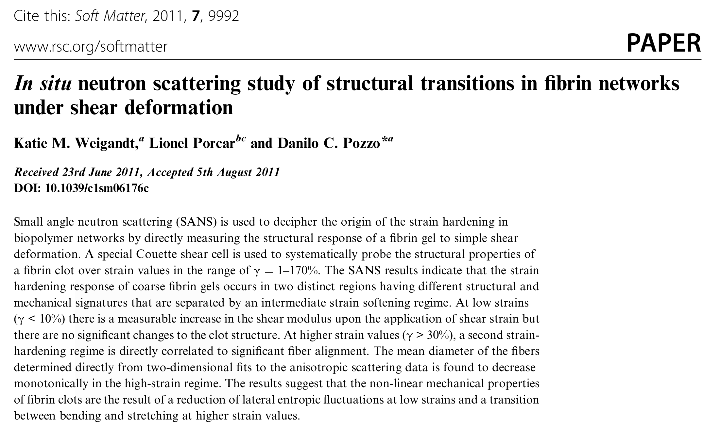
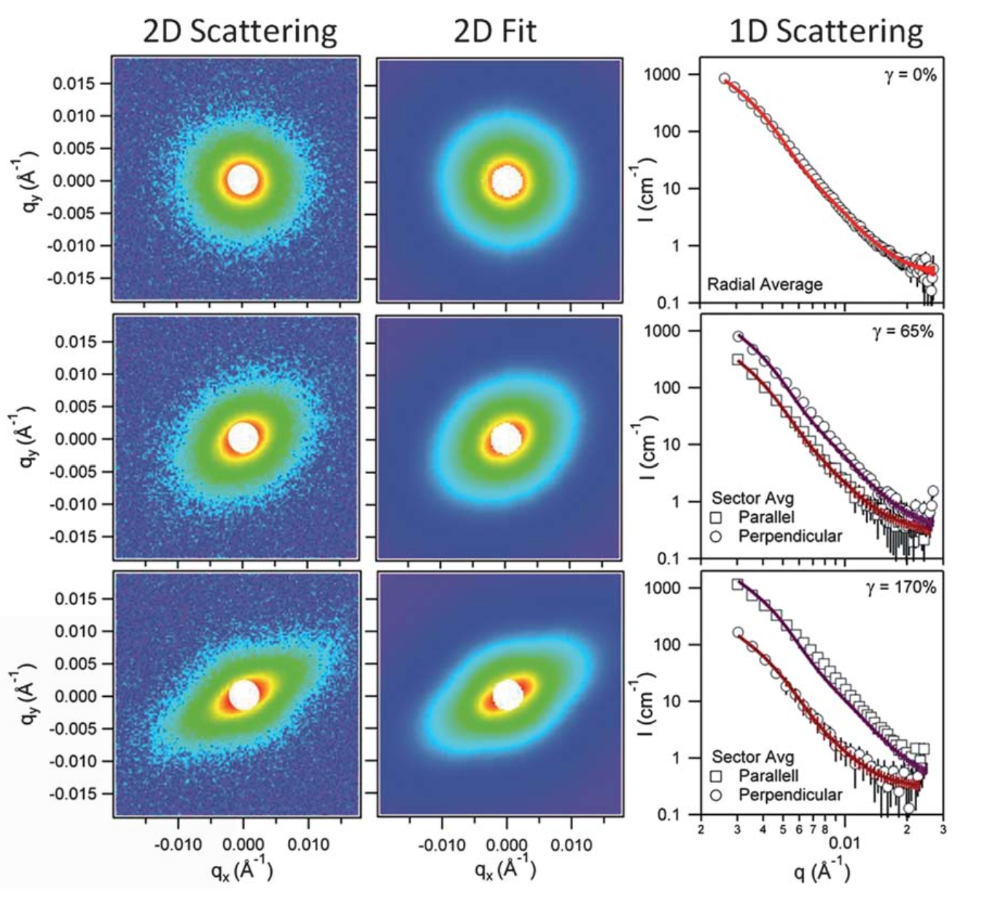
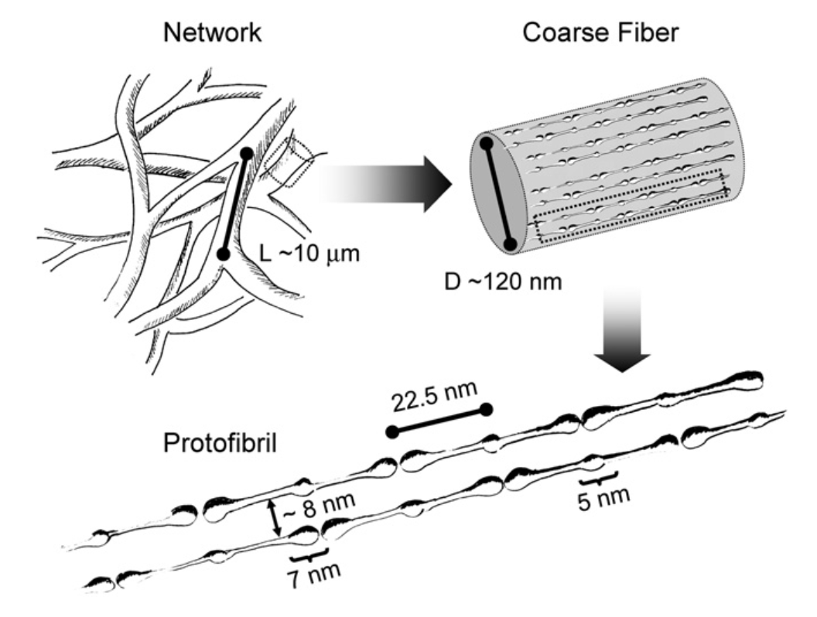
2D Modelling

Slide 26
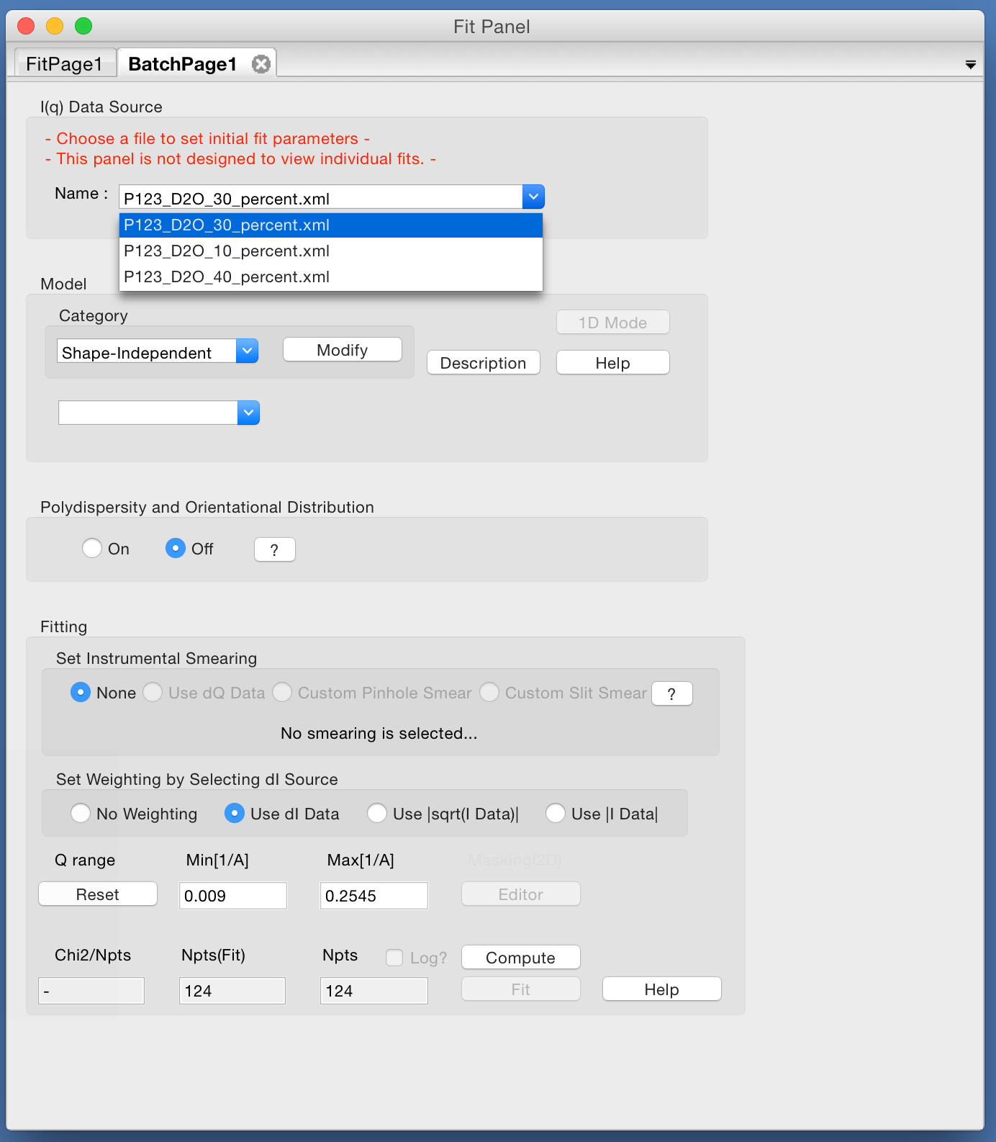
Other Features
Batch fitting …

Slide 27
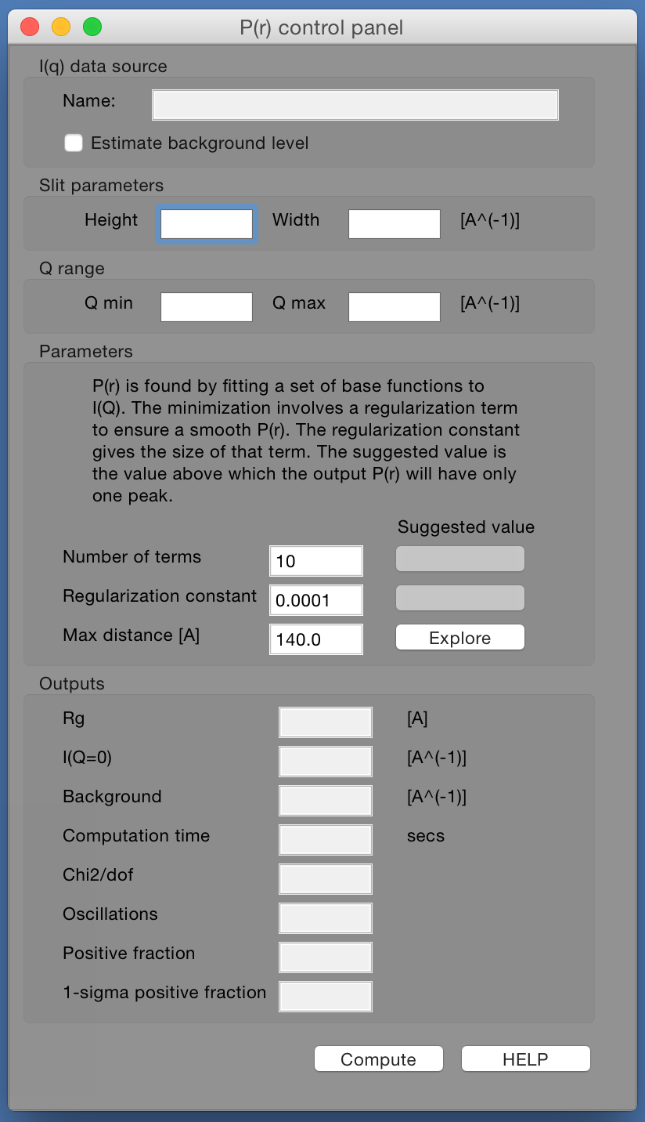
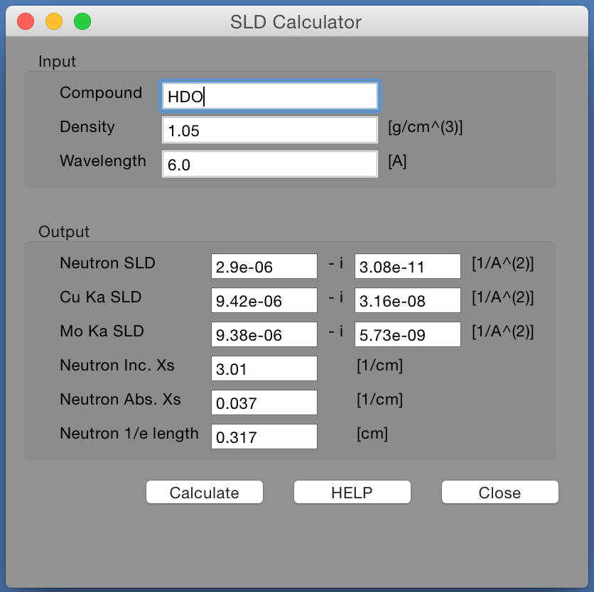
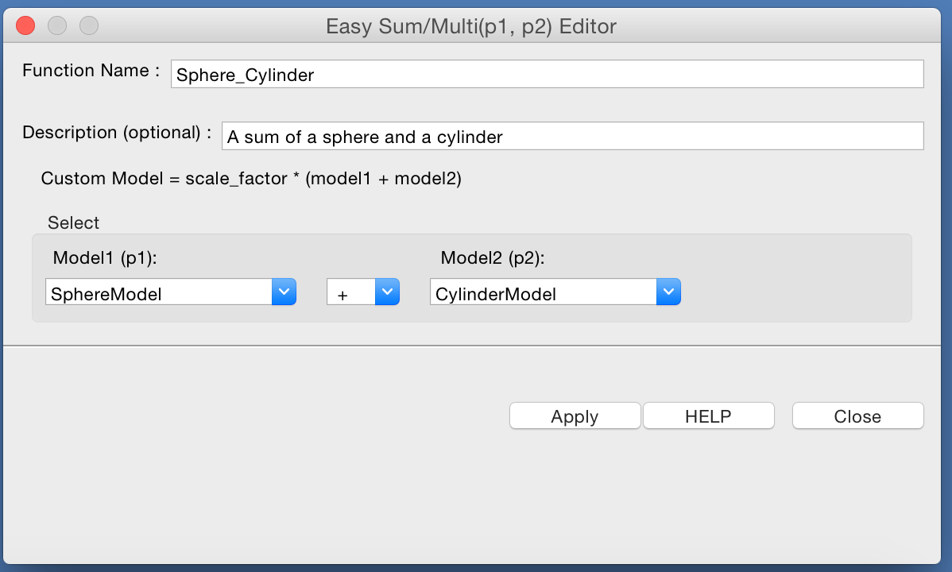
Other Features
SLD Calculator …
P(r) Inversion …
Sum & Multiplication of Models …

Slide 28
SasView Development

Slide 29



A little history …
Where did SasView come from?
DANSE project output
~ 8.5% of funds were for SANS
Kickoff meeting August 2006
Heritage: NIST IGOR macros

Slide 30
Continuity …
NIST Supported initial transition from NSF funding

Slide 31
Expansion …
NIST Supported initial transition from NSF funding
Now 7 active facilities
ORNL, ISIS, NIST, ESS, ILL, TUD/RID, ANSTO
SINE2020 Funding at ESS
First major investment since DANSE
http://sine2020.eu

Slide 32
Development Model
Open, Collaborative, Community Development
Code is open source and publicly hosted at Github
Bi-weekly developer calls
Code Camps
1st at NIST April 2013
2nd at ISIS April 2014
3rd at ESS Feb 2015
4th in Delft hosted by TU Delft / RID March 2016
5 Year Roadmap
http://www.sasview.org
http://github.com/SasView

Slide 33
The Future … is Now!
SESANS
Automatic transform of SANS model to P(z)
Example scripts for fitting SESANS data
Simultaneous fitting of SANS & SESANS
Integration of SESANS fitting into GUI
Models
New models
New model package (sasmodels)
separation of models from GUI
simpler addition of models by users
speed! GPU and parallel processing
Documentation
Enhanced, updated documentation for models

Slide 34
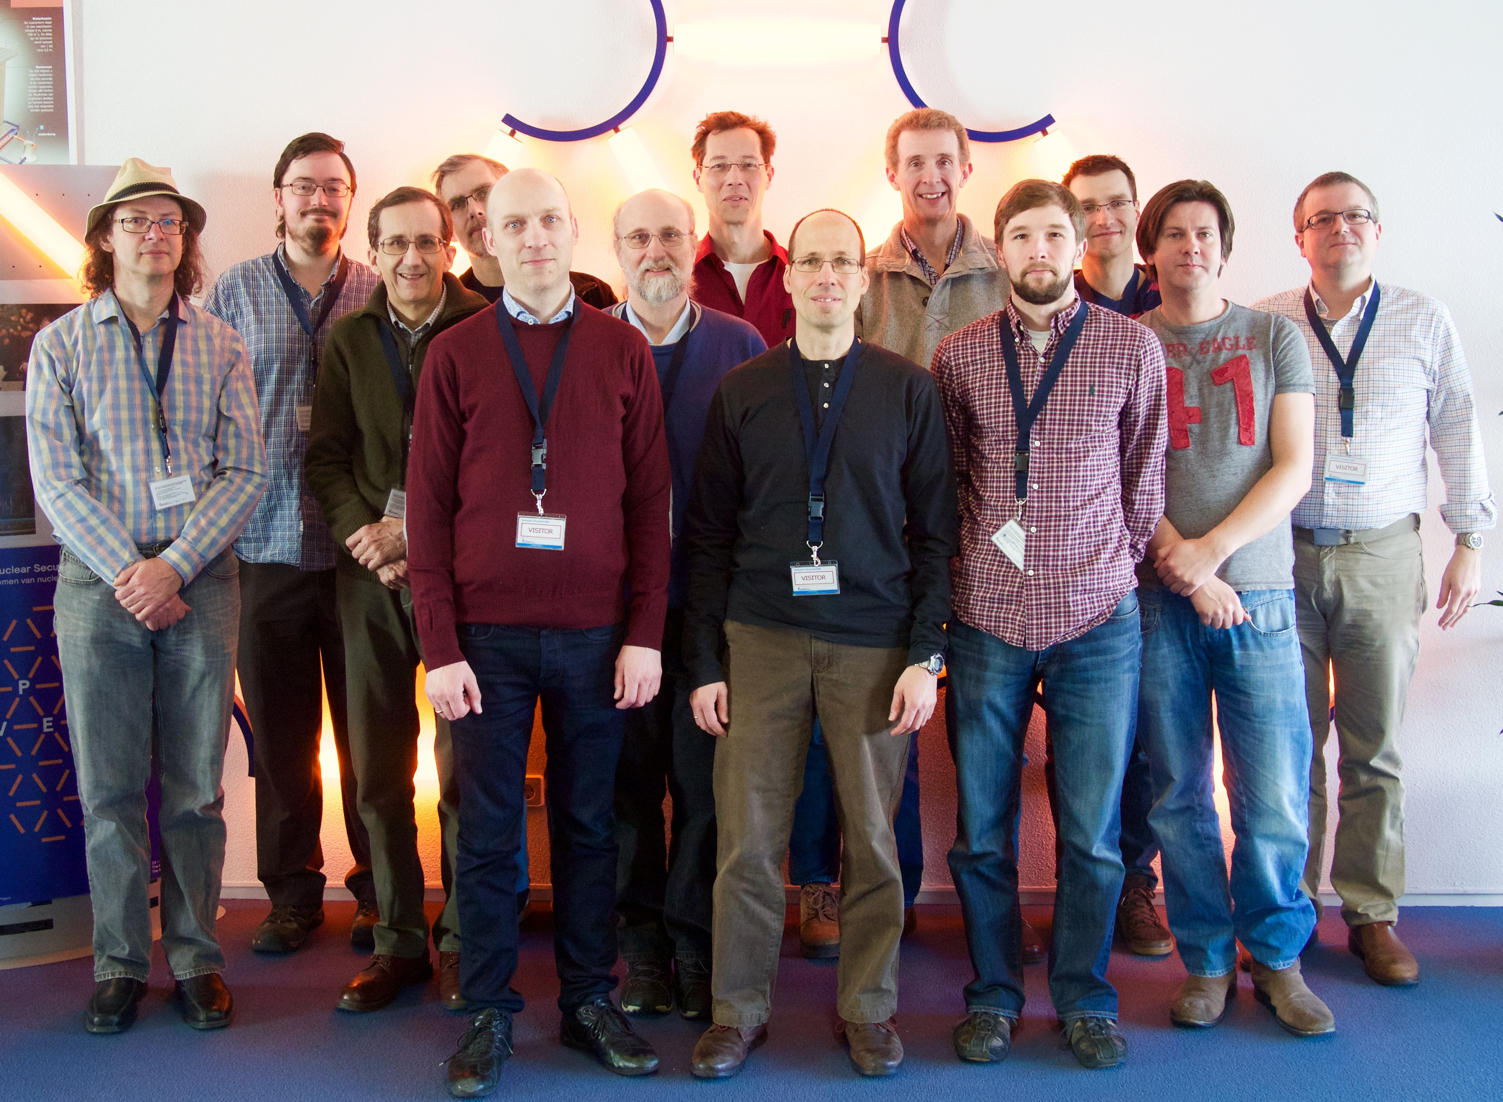
Current Development Team
Paul Butler (NIST)
Mathieu Doucet (ORNL)
Steve King (ISIS)
Andrew Jackson (ESS)
Jurrian Bakker (TUD)
Wim Bouwman (TUD)
Miguel Gonzales (ILL)
Richard Heenan (ISIS)
Paul Kienzle (NIST)
Jeff Kryzwon (NIST)
Ricardo Leal (ORNL)
David Manicke (ANSTO)
Torben Nielsen (ESS)
Steve Parnell (TUD)
Wojciech Potrzebowski (ESS)
Piotr Rozyczko (ESS)
Adam Washington (Sheffield)
and thanks to the many previous contributors, particularly Jae Hie Cho and Alina Gervaise
Questions?

Slide 36
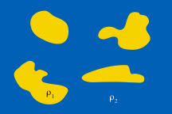
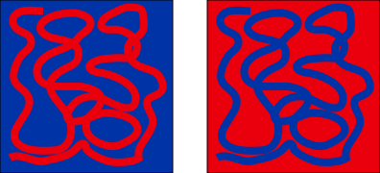
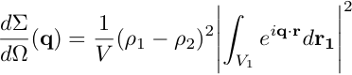
Small Angle Scattering
For a general two phase system, the Rayleigh-Gans equation leads to the result that :
and we see that as a result of the macroscopic cross section being a function of the square of the amplitude of the fourier transform of the SLD distribution, we are only sensitive to the absolute difference in SLD between the phases and not the sign.
This is known as Babinet’s Principle and means that small angle scattering cannot determine if ρ1 is greater than ρ2 from a single measurement. Thus we need additional information about the system or we need to use contrast variation.
The integral term in the equation is known as the scattering structure factor S(q) and describes the distribution of matter in the sample.

Slide 37
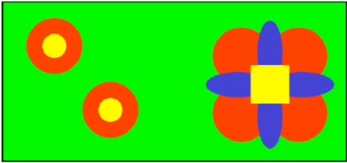
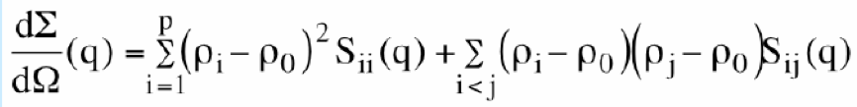
Contrast Variation and Matching
In the case of ‘p’ different phases in a matrix ‘0’
Scattering is now the sum of several terms with possibly many Sij components

Slide 38
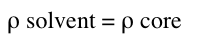

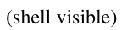
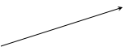
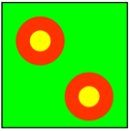
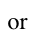
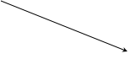
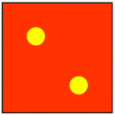
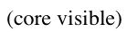
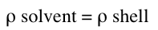
Contrast Variation and Matching

Slide 39

Contrast Variation and Matching
Caution! The SLD of the component you are interested in may vary with the solvent SLD either through hydrogen exchange (e.g. proteins) or through penetration of the solvent into the component (e.g. block copolymer micelles)

